Slide 1
Dept. of AIML,
AMC Engineering College, Bangalore, Karnataka
Title: A Hybrid Approach to Detect and Diagnosis of Disease using Machine Learning Model.
Authors name
1. SABARI V E
2. Nadiya afsheen
3. Gokul

Slide 2
TABLE OF CONTENTS
Introduction
Problem Statement
Literature Review/Related Work
Research Methodology
System Architecture/Design
Experimental Setup
Results and Discussion
Conclusion
Future Work
Acknowledgments
References

Slide 3
Introduction
Health Impact of Chronic Diseases: Chronic conditions like diabetes, heart disease, and Parkinson's significantly affect individuals' daily lives and the healthcare system at large. Addressing these diseases through early diagnosis is crucial.
Significance of Early Detection: Timely identification and accurate prediction of these diseases can greatly improve health outcomes, reducing long-term complications and healthcare costs.
Emergence of Machine Learning (ML): Machine learning has become a powerful tool in the healthcare industry, capable of analyzing vast datasets to find patterns that can predict the onset of diseases.
Scope of the Research: This study applies ML techniques to predict three specific diseases: diabetes, heart disease, and Parkinson’s disease. By leveraging data, we aim to increase the accuracy of early detection.
User-Friendly Solution: Our goal is to create a web application that allows patients to input their health metrics and obtain a disease prediction with minimal effort, providing users with a simplified and efficient experience.

Slide 4
Problem Statement
Challenge of Predicting Multiple Diseases: Predicting diseases like diabetes, heart disease, and Parkinson’s from a single input system is a complex task due to differing symptoms, health data, and disease progressions.
Importance of Early Diagnosis: Early detection is essential in mitigating the risks associated with chronic diseases. Delay in diagnosis can lead to more severe health outcomes.
Current Diagnostic Limitations: Current medical diagnostic methods are not only time-consuming but often only focus on one disease at a time, rather than allowing multi-disease detection.
Need for a Unified Solution: There is a need for an integrated solution that can predict multiple diseases simultaneously, providing patients with a comprehensive view of their health.
Web Application as a Solution: Our solution aims to combine various machine learning algorithms to offer early and accurate disease prediction through an easy-to-use web interface, making healthcare more accessible.

Slide 5
Literature Review/Related Work
Existing Research on Disease Prediction Using ML: Overview of studies that have applied machine learning to healthcare, especially for diabetes, heart disease, and Parkinson’s disease. Highlight some key results, such as improvements in accuracy.
Comparison of Machine Learning Algorithms: Explain the benefits and limitations of various models like Logistic Regression, SVM, Artificial Neural Networks (ANN), and Decision Trees for disease prediction.
Hybrid Approaches for Enhanced Prediction: Some studies have used combinations of models to improve accuracy. Discuss how these approaches work and their effectiveness.
Success Rates in Existing Research: Present data on the accuracy rates achieved in previous research for each disease. Example: SVM has shown 87% accuracy for Parkinson’s prediction.
ICMR Dataset Usage: Highlight research that has used large-scale datasets like ICMR (Indian Council for Medical Research) to improve disease detection models.
Improvements in Early Detection: Recent research has shown that using machine learning significantly improves early disease detection compared to traditional methods.
Limitations of Current Models: Discuss the shortcomings of existing machine learning models, such as overfitting or limited generalizability, and the need for further validation.

Slide 6
Research Methodology
Data Collection: Collected data from reliable sources like ICMR and public health databases, ensuring a wide variety of features such as demographic, clinical, and lifestyle data.
Data Preprocessing: Steps taken to clean the data, such as handling missing values, removing outliers, and standardizing data for better model performance.
Feature Engineering: Selected important features (e.g., glucose levels for diabetes, heart rate for heart disease) and created new ones based on domain knowledge to improve prediction accuracy. Model
Selection: Choosed machine learning models like Logistic Regression, SVM, Decision Trees, and Neural Networks based on their suitability for specific diseases.
Model Training: Trained models using 80% of the dataset, ensuring the model learns to recognize patterns while avoiding overfitting.
Model Evaluation: Evaluated models based on accuracy, precision, recall, F1-score, and AUC-ROC to determine the best-performing algorithm.
Web Application Development: Used Streamlit to create a user-friendly web interface where patients or healthcare providers can input data to get predictions on multiple diseases.

Slide 7
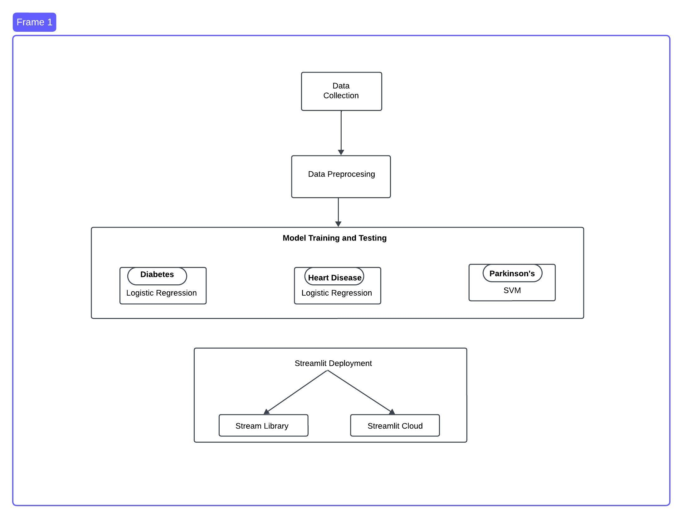
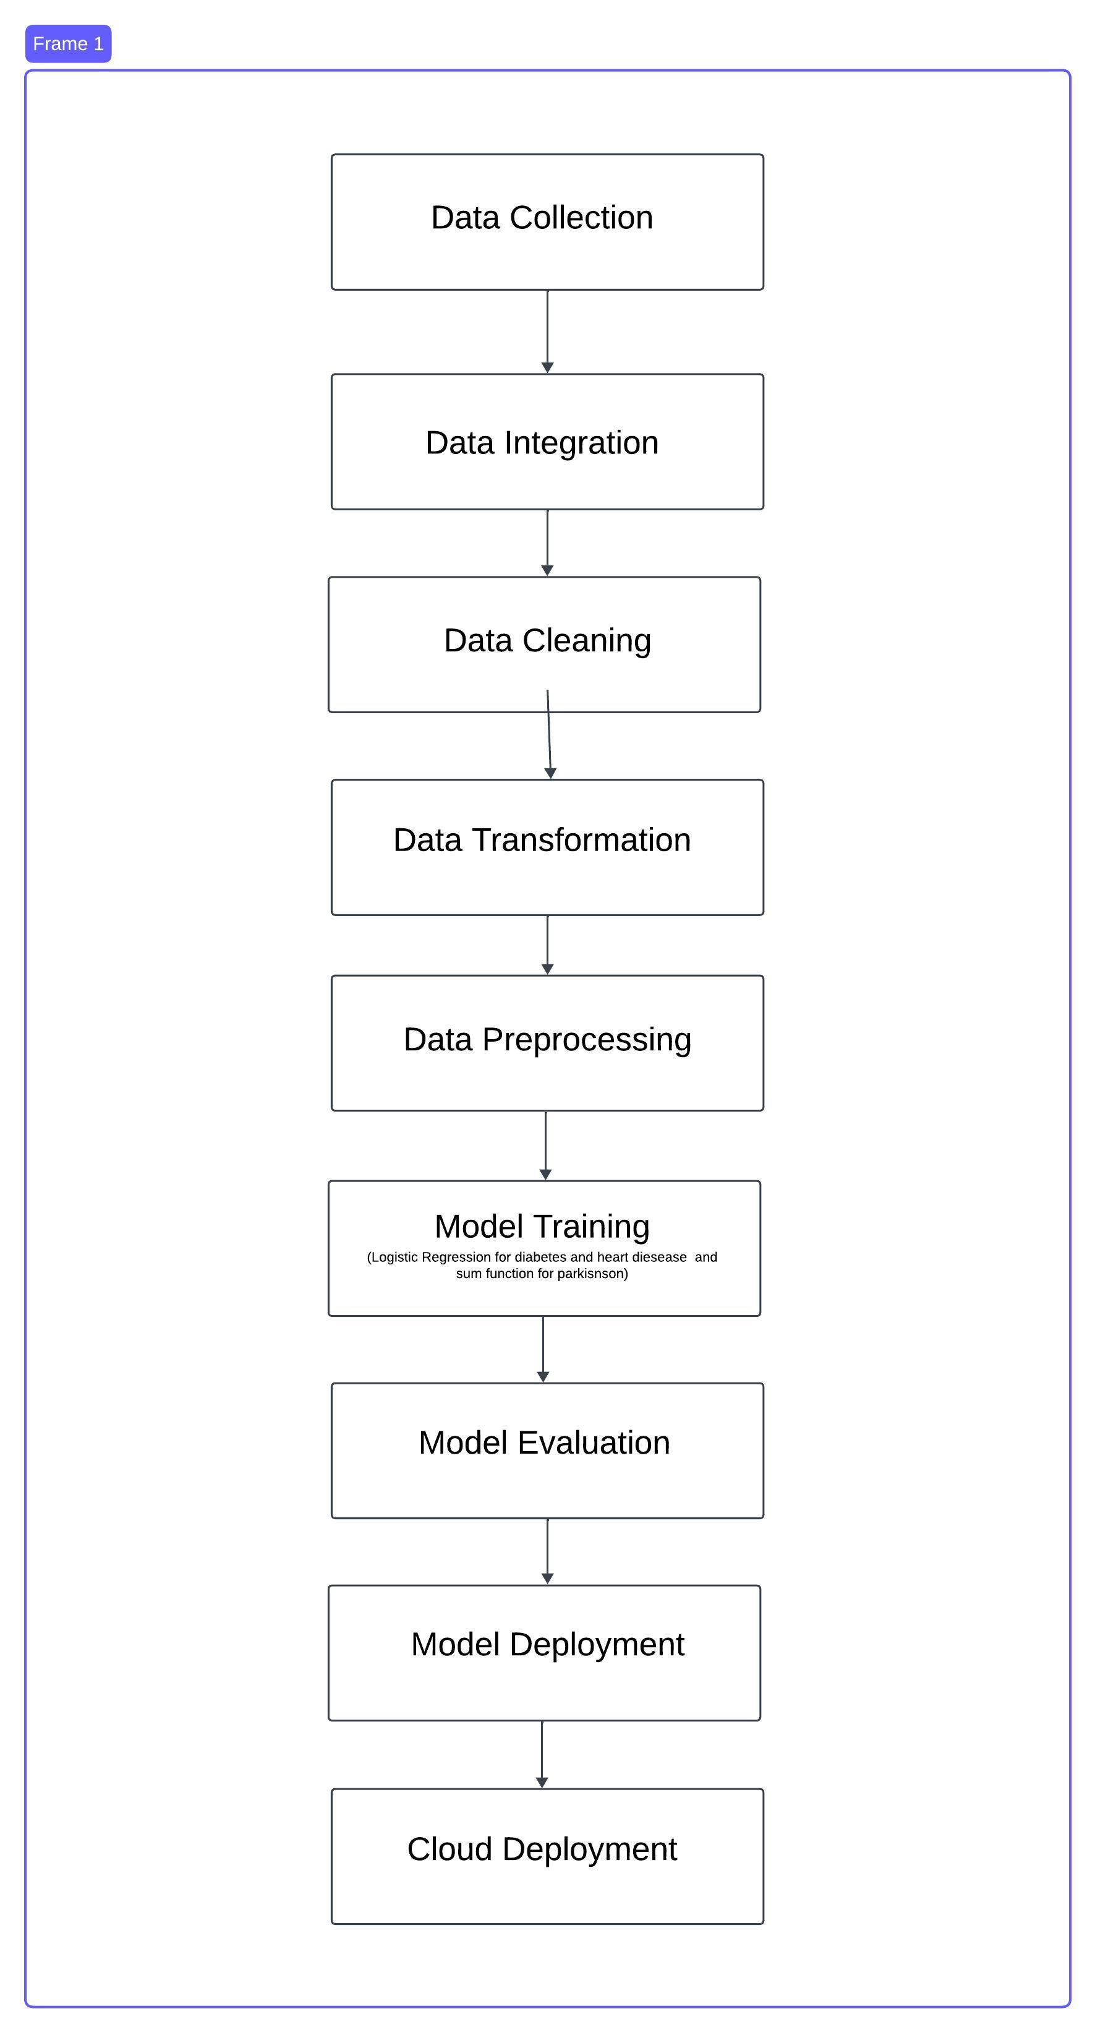
System Architecture/Design

Slide 8
Experimental Setup
Dataset Description: Overview of the datasets used (ICMR, public health databases), including the number of samples, types of features (demographics, medical history), and diseases covered.
Model Training Process: Trained models like Logistic Regression and SVM using 80% of the data, optimized hyper parameters using Random Search.
Performance Evaluation: Evaluated models based on accuracy, precision, recall, F1-score, and ROC-AUC to determine the best model for each disease.
Diabetes Prediction: Trained Logistic Regression on the diabetes dataset, achieving an accuracy of 77.6%.
Heart Disease Prediction: Used Logistic Regression and SVM, achieving an accuracy of 83.84% for heart disease prediction.
Parkinson’s Disease Prediction: Trained SVM and Decision Trees, achieving the highest accuracy of 87.17%.
Testing and Validation: Split the dataset into training and testing sets to ensure that the model can generalize well to unseen data.

Slide 9
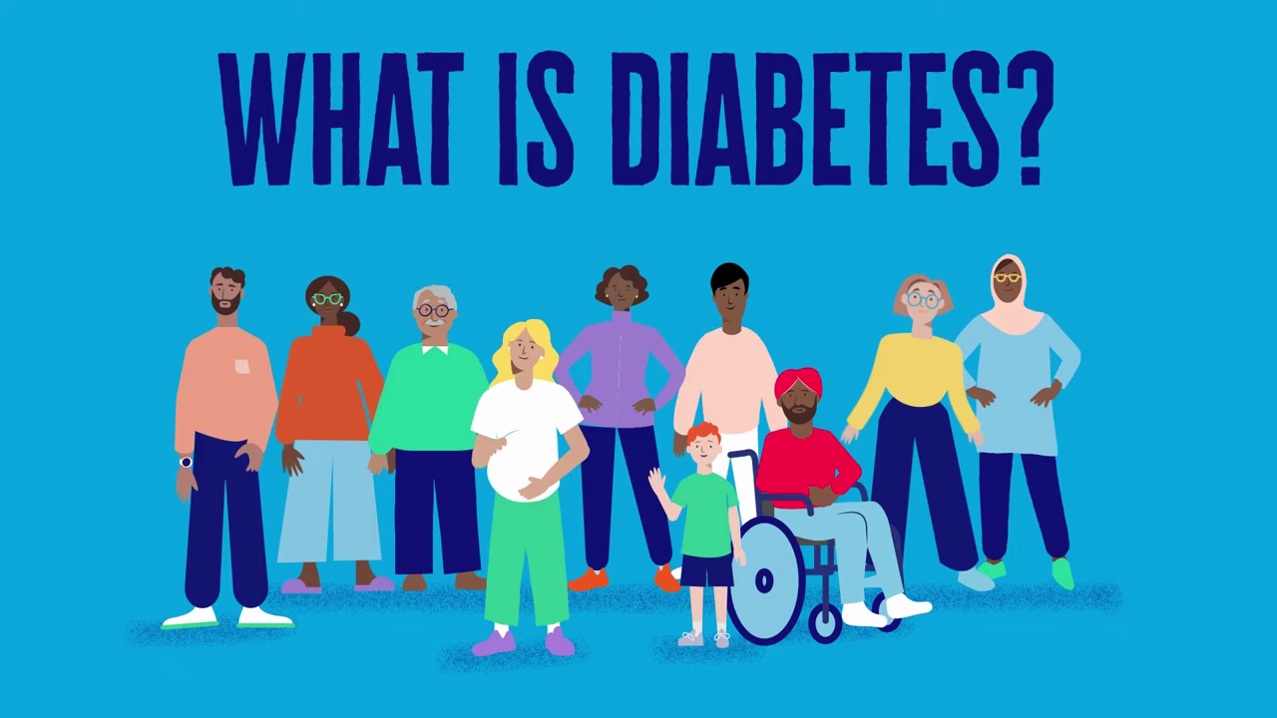

Slide 10
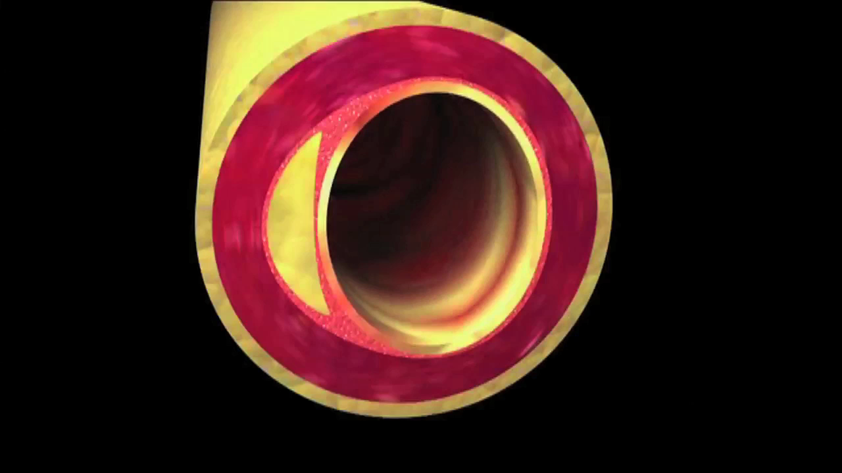

Slide 11


Slide 12
Results and Discussion
Disease | Logistic Regression | SVM | KNN | Accuracy
Diabetes | 77.60 | 75.64 | 75.5 | 77.60
Heart Disease | 82.50 | 78.87 | 83.84 | 83.84
Parkinson’s | 86.42 | 84.63 | 87.17 | 87.17

Slide 13
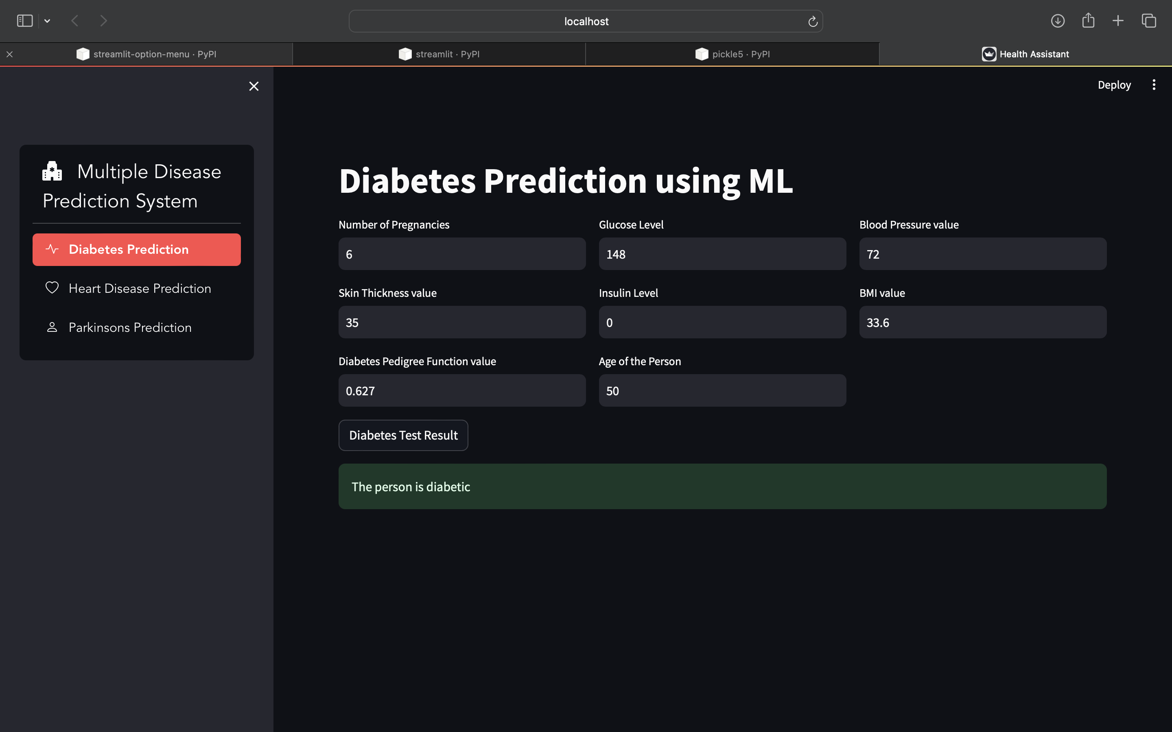

Diabetes Prediction

Slide 14
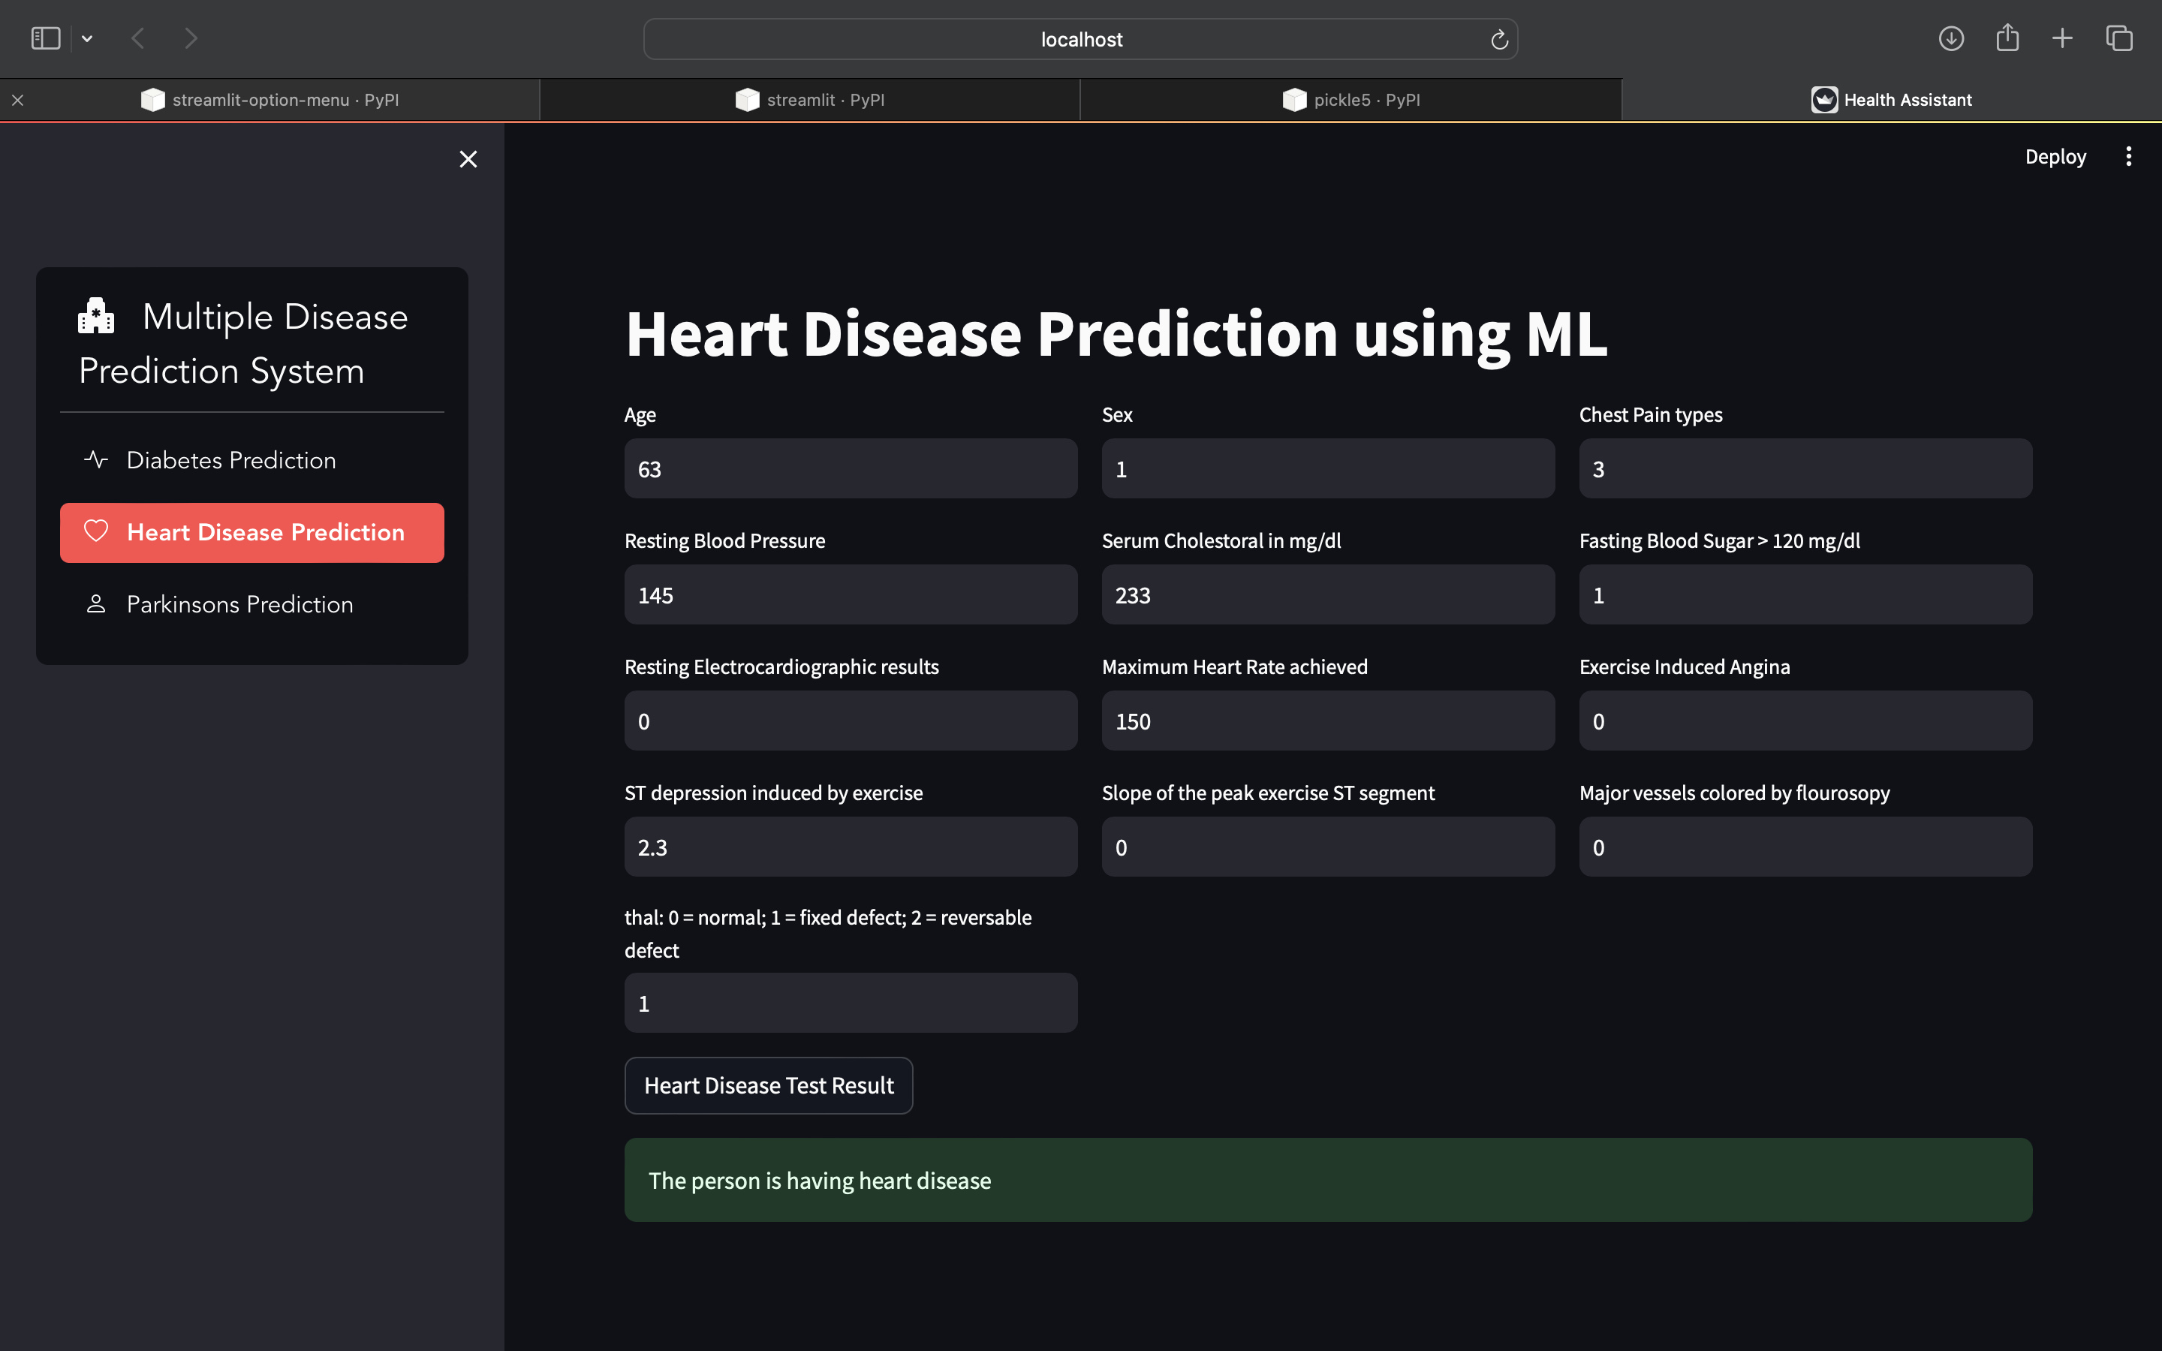

Heart Disease Prediction

Slide 15
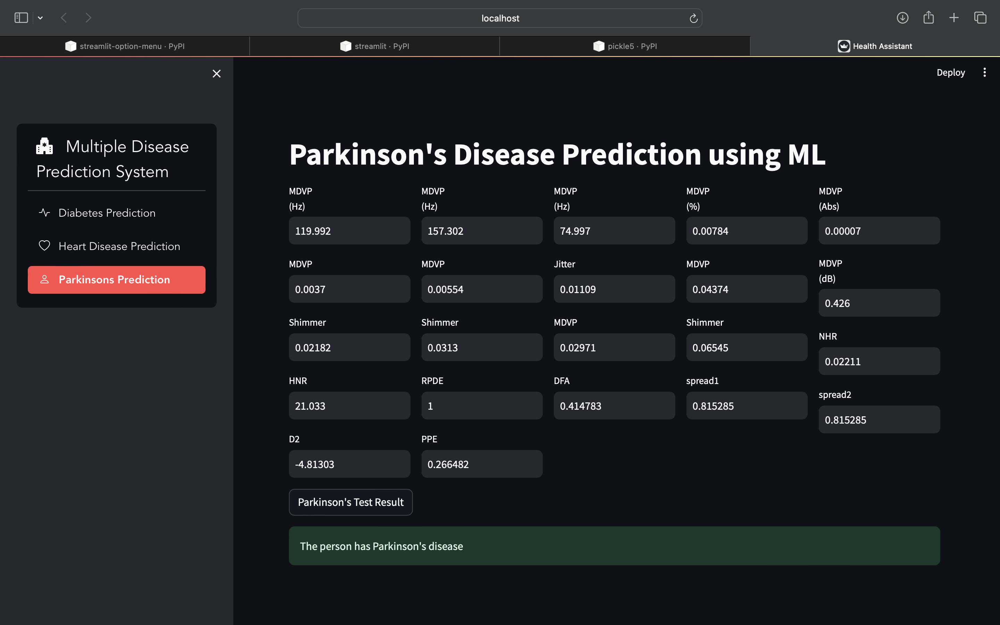

Parkinson’s Disease prediction

Slide 16
Result and Discussion
Accuracy Comparison: Presented the accuracy of different algorithms (Logistic Regression, SVM, KNN) for each disease.
Diabetes Prediction Results: Achieved an accuracy of 77.6% with Logistic Regression, which outperformed SVM and KNN for this dataset.
Heart Disease Prediction Results: Achieved an accuracy of 83.84% using Logistic Regression, with SVM following closely behind.
Parkinson’s Disease Prediction Results: Achieved an accuracy of 87.17% using SVM, making it the best model for this disease.
Discussion on Accuracy: Discussed the range of accuracy (70%-85%) and how model optimization improved these results.
Challenges in Data Quality: Faced issues like missing values and inconsistent data, which were addressed through data cleaning techniques.
Limitations and Areas for Improvement: Limitations in model generalizability, the need for larger datasets, and potential biases in patient data.

Slide 17
Conclusion
Importance of Early Disease Detection: Emphasized the critical role that early diagnosis plays in improving patient outcomes and preventing disease progression.
Success of Machine Learning Models: Discussed the success of ML models in predicting multiple diseases, achieving high accuracy rates.
Impact on Patient Care: ML models provides real-time predictions, enabling doctors to take timely action, thus improving patient outcomes.
Technology’s Role in Healthcare: ML and AI are transforming how we approach disease detection, allowing for more personalized, data-driven decisions.
Future Potential: The use of AI and ML in healthcare has the potential to revolutionize chronic disease management by providing more efficient and accurate diagnosis tools.

Slide 18
Future Work
Enhancing Model Interpretability: Focusing on making machine learning models more interpretable for clinicians, helping them understand the reasoning behind predictions.
Expanding the Dataset: Incorporating a larger and more diverse dataset to improve the robustness and generalizability of the model.
Integrating Real-Time Data: Currently working on by Integrating more diseases into the system to provide access to all disease predictions at one place. Eg Kidney disease, Cancers, Respiratory disease.

Slide 19
Acknowledgement
I would like to express my gratitude to AMC Engineering College for providing the academic framework and resources needed to conduct this research.
My special thanks to our professors and mentors who guided us throughout the project with their valuable insights and suggestions.
I Acknowledge the contribution of the Indian Council of Medical Research (ICMR) and other health organizations for providing the necessary datasets.
Thanks to my colleagues and peers for their constructive feedback and suggestions, which played a vital role in shaping this project.
Finally, heartfelt thanks to our families for their unwavering support and encouragement throughout this research journey.

Slide 20
References
1. Arumugam, K., Naved, M., Shinde, P.P., Leiva-Chauca, O., Huaman-Osorio,A. and Gonzales-Yanac, T., 2023. Multiple disease prediction using Machine Learning algorithms. Materials Today: Proceedings, 80, pp.3682-3685.
2. Harimoorthy, K. and Thangavelu, M., 2021. Retracted article: Multi_x0002_diseaseprediction model using improved SVM-radial bias technique in healthcaremonitoring system. Journal of Ambient Intelligence and Humanized Computing, 12(3), pp.3715-3723.
3. Xie, S., Yu, Z. and Lv, Z., 2021. Multi-disease prediction based on deeplearning: a survey. Computer Modeling in Engineering & Sciences, 128(2),pp.489-522.
4. Men, L., Ilk, N., Tang, X. and Liu, Y., 2021. Multi-disease prediction usingLSTM recurrent neural networks. Expert Systems with Applications, 177,p.114905.
5. Yang Q, Khoury MJ, Botto L, Friedman JM, Flanders WD. Improving the prediction of complex diseases by testing for multiple disease-susceptibility genes.The American Journal of Human Genetics. 2003 Mar 1;72(3):636-49.

